Slide 1
Enron North America Gas Logistics
An Overview

Slide 2
Gas Logistics Introduction
Gas Logistics is part of the Energy Operations group under the Enron Networks organization
Partners with the Commercial, Origination and Settlements teams to optimize value and minimize operational risk

Slide 3
Gas Logistics Introduction
Responsible for the scheduling of all physical transactions
Coordinates movement of gas across national pipeline grid
Acts as bridge between Commercial desks and Settlements team
Works to minimize operational risk and identify opportunities to add value
Coordinates operational issues & acts as liaison for asset management customers

Slide 4
Timely/Intraday Nomination Timeline
(All Times Central Clock Time)
Calendar Day 10th
Gas Day 11th
Evening*
Bump
6:00 PM
12 AM
12 AM
Timely*
11:30 AM
9:00 AM
3:30 PM
4:30 PM
9:00 PM
10:00 PM
Timely Noms due
for Gas Day 11th
Timely
Operator
Confirmation
Timely
Scheduled
Quantities
Available
Evening
Noms due
Evening
Operator
Confirmation
Evening
Scheduled Quantities
Available
Calendar Day 11th
12 AM
Intraday 1*
Bump
10:00 AM
Gas Day 11th
Intraday 2*
5:00 PM
12 AM
9:00 AM
1 PM
2:00 PM
8:00 PM
9:00 PM
Gas Day ends
11th begins
Intraday 1
Noms due
(Gas Flow to
begin @ 5:00pm)
Intraday 1
Operator
Confirmation
Intraday 1
Scheduled
Quantities
Available
    Intraday 2
    Noms due
    (Gas Flow to
    begin @ 9:00pm)
Intraday 2
Operator
Confirmation
Intraday 2
Scheduled
Quantities
Available
Calendar Day 12th
12 AM
Gas Day 11th
12 AM
9:00 AM
9:30 AM
Gas Day
11th ends
Final
Scheduled
Volumes
Available
*Allow 15 minutes for EDI/EDM

Slide 5
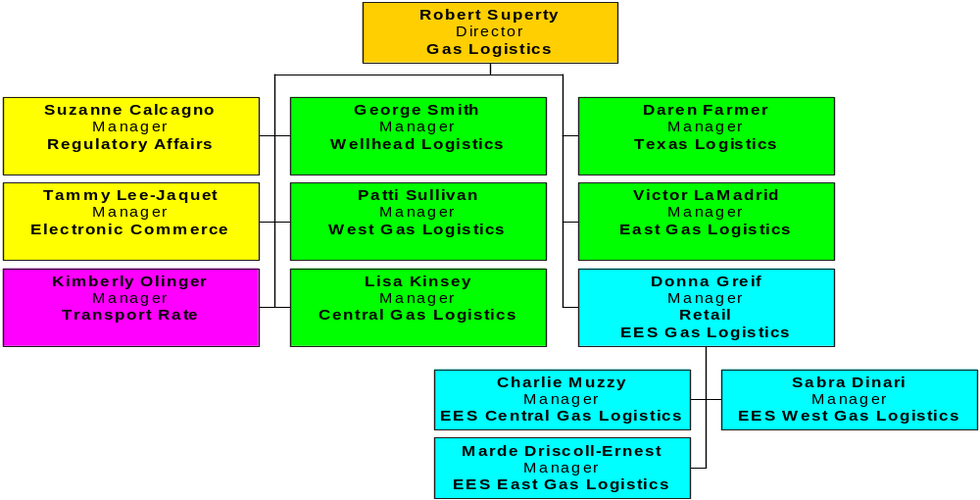
Gas Logistics

Slide 6

Gas Logistics Headcount
Traders = 57
Schedulers = 80+

Slide 7
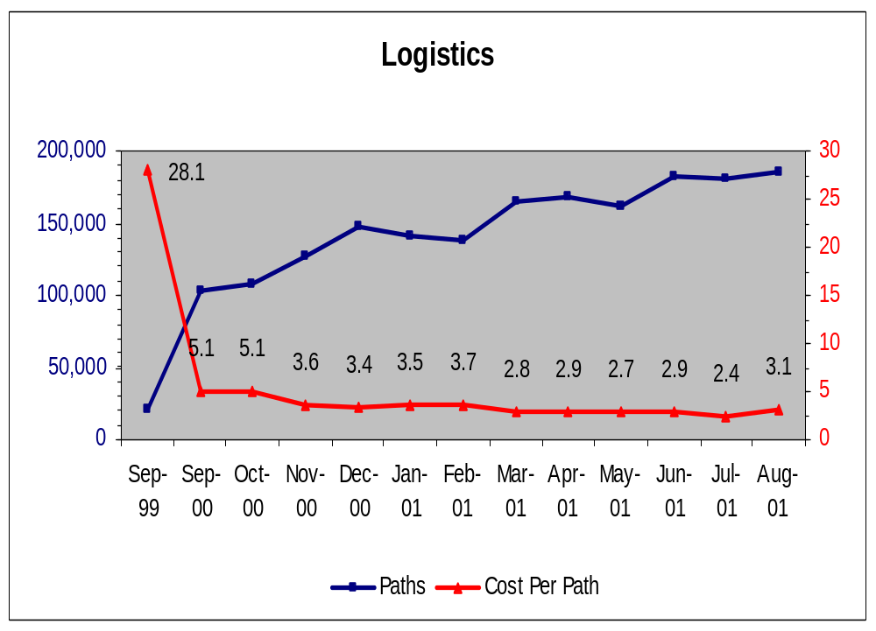
Logistics: Number of Paths & Cost Per Path
Since September 1999 the Cost per Path has decreased as the Number of Paths has increased.

Slide 8
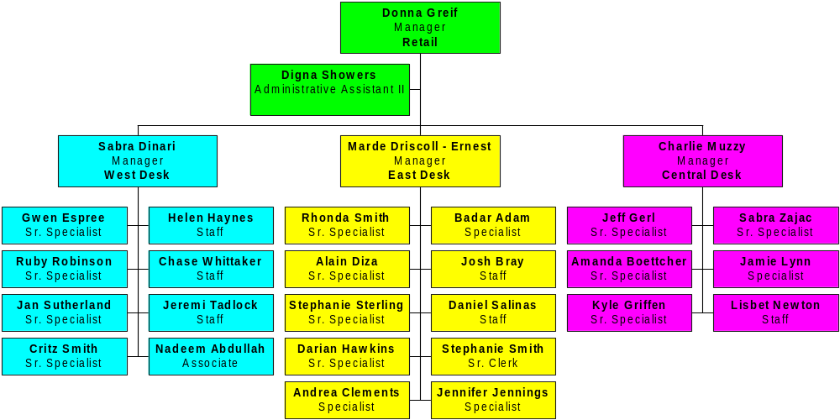
EES Gas Logistics

Slide 9
EES Gas Logistics Information
Manages an excess of 16,000 deals supplying gas to approximately 15,000 counterparts.
Nominations sent to approximately 30,000 meters on approx. 30 pipelines and behind approx. 100 LDC’s.
Customer account management includes load forcasting, consumption management, daily & monthly account balancing, daily scheduling, internal deal pricing and volumetric capture across 4 un-integrated systems, as well as storage and synthetic storage account management.
Establishes, communicates, and confirms delivery instructions with buyers and sellers.
Receives invoices relating to product transportation & reviews economic terms.

Slide 10
EES Gas Logistics Information
Support commercial teams – daily intelligence gathering, including pipeline information, position worksheets, storage levels, and any other data deemed critical or useful to traders/originators.
Monitor day forward trades to ensure books are flat
Monitor trading activities (internal & external)
Resolve issues that stem from trading (bridge monitoring)
Report daily, monthly, year to date, etc. . .trading activities.

Slide 11
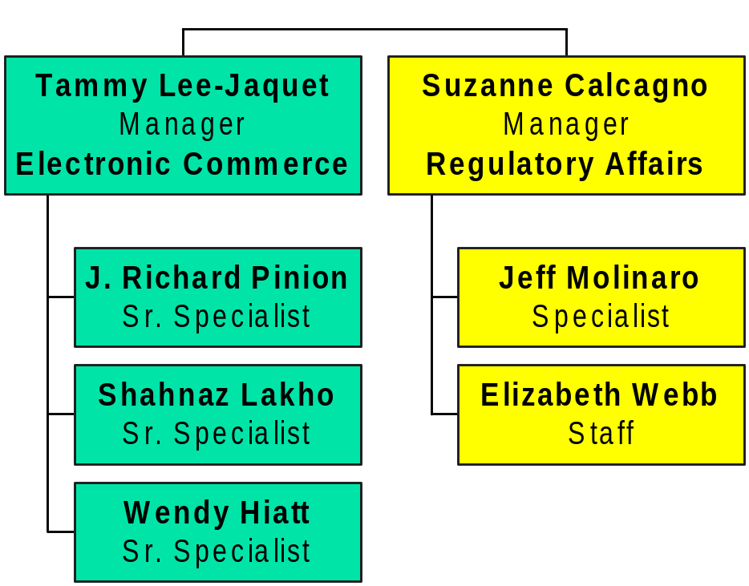
Electronic Commerce/Regulatory Affairs

Slide 12
Electronic Commerce Information

Slide 13
Regulatory Affairs Information

Slide 14
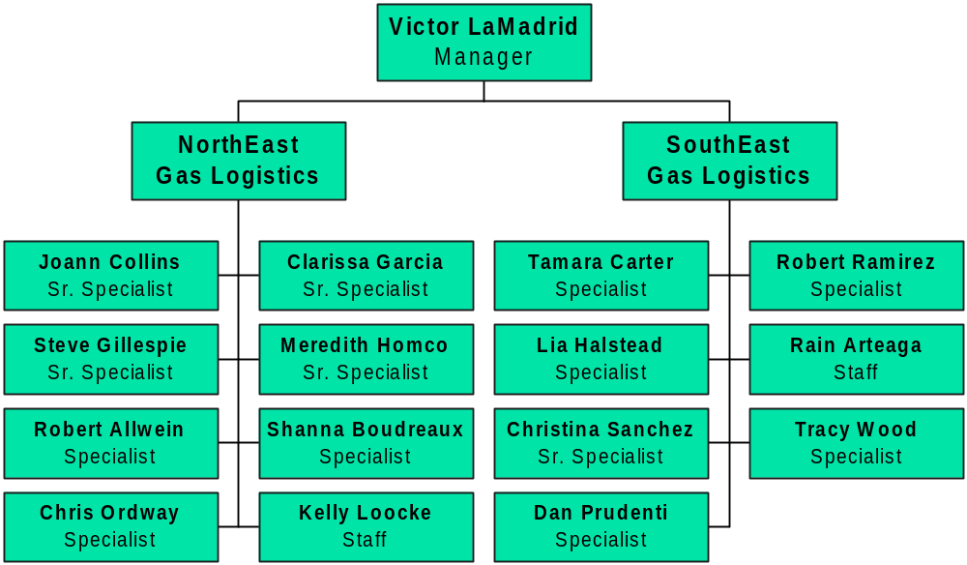
East Gas Logistics

Slide 15
SouthEast Pipelines
Acadian Pipeline
Bridgeline
Cavallo Pipeline
Central Texas Gathering System
Chandeleur Pipe Line
Citrus
Columbia Gulf
Cyprus
Destin
Discovery
Florida Gas
Garden Banks
Green Canyon Pipeline
KOCH Gateway/United
KOCH Midstream
Louisiana Intrastate Gas
MOPS – Florida
Sabine Pipeline
Sabine Hub
Sea Robin
South Georgia Pipeline
Southern Natural
Tennessee
Stingray
Texas Gas Transmission
Venice Gas Gathering System

Slide 16
NorthEast Pipelines
Alabama Tennessee
Algonquin
Central Texas Gathering System
Columbia Natural Resources
Columbia Gas of Kentucky
Columbia Gas Transmission
Columbia Gulf
Consolidated Natural Gas
Cove Point
Eastern American Energy
Eastern States Energy
East Ohio Gas
East Tennessee
EGSI (Exxon)
Equitran
Gatherco
Hattiesburg Storage
Iroquois
Leviathan Gas
Marco
National Fuel
New Waskom
Norse
Olympic Pipeline
Somerset
Tennessee Gas
Tennessee River Intrastate
Texas Eastern
Transco
Transco Louisiana Intrastate
Venice Gas Gathering System

Slide 17
East: Asset Management Deals

Slide 18
East Gas Logistics Information

Slide 19
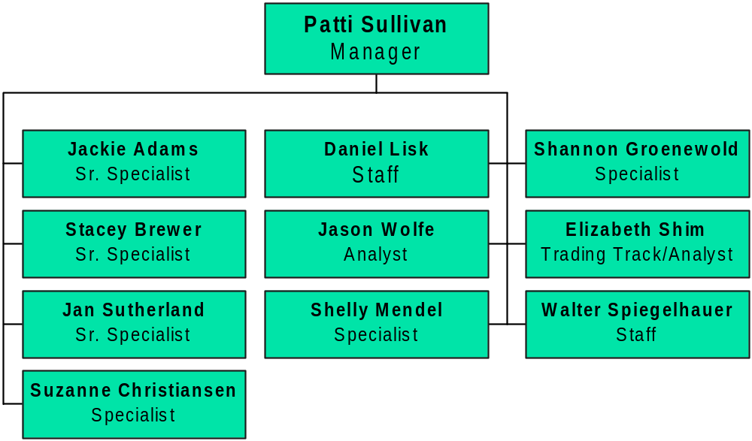
West Gas Logistics

Slide 20
West Pipelines
Colorado Interstate
El Paso Natural Gas
Fort Union (FUGG)
Hub Services (Park)
Kern River
Lost Creek (LCG)
Montana Power
Northwest Pipeline
Pacific Gas & Electric
Pacific Gas Transmission
Public Sevice of Colorado
Questar
Rulison Gas Company, LLC
SoCal Storage
Southern California Gas
Sumas (SIPI)
Trailblazer Pipeline
Transwestern
Williston Basin
Wyoming Interstate Co.
Williams Field Services

Slide 21
West: Asset Management Deals

Slide 22
West Gas Logistics Information

Slide 23
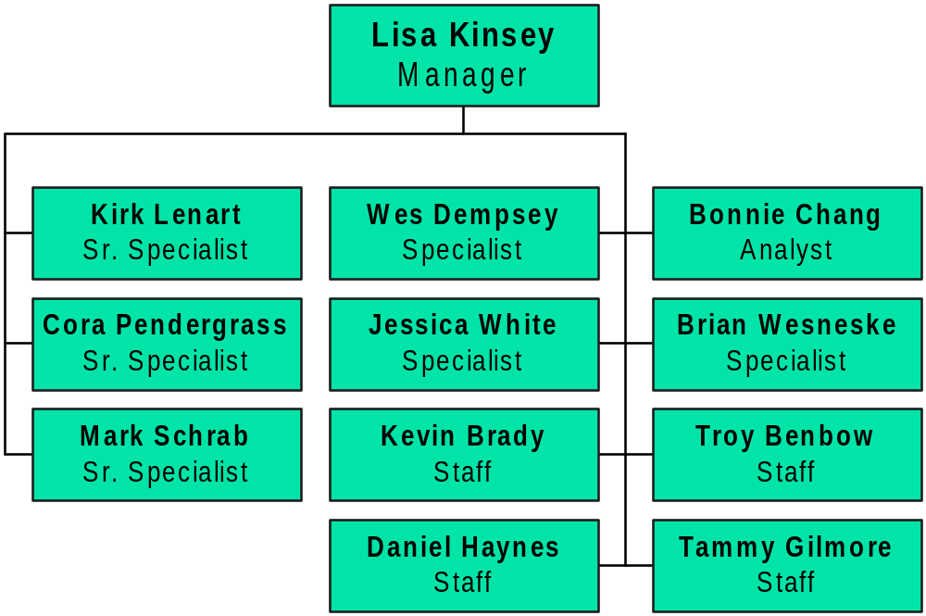
Central Gas Logistics

Slide 24
Central Pipelines
ANR Field Services
ANR Pipeline
Consumer’s Energy Co.
Empire
Enogex
Enron Gas Gathering
GPM Gas/GPM
Great Lakes Gas Transmission
Michcon
Mississippi River
Natural Gas Pipeline
NorAm Field Services
NorAm (ARKLA)
Northern Border
Northern Natural Gas
Northern Illinois Gas Company
Northern Indiana Public Service Co.
Oklahoma Natural Gas
Panhandle Eastern Pipeline
Panhandle Field Services
TCPL
The People’s Gas Light & Coke
Transok
Trunkline
Union
Williams Natural Gas

Slide 25
Ontario Pipelines
Ontario Region
TCPL
UGL
Dawn

Slide 26
Central: Asset Management Deals

Slide 27
Central Gas Logistics Information

Slide 28
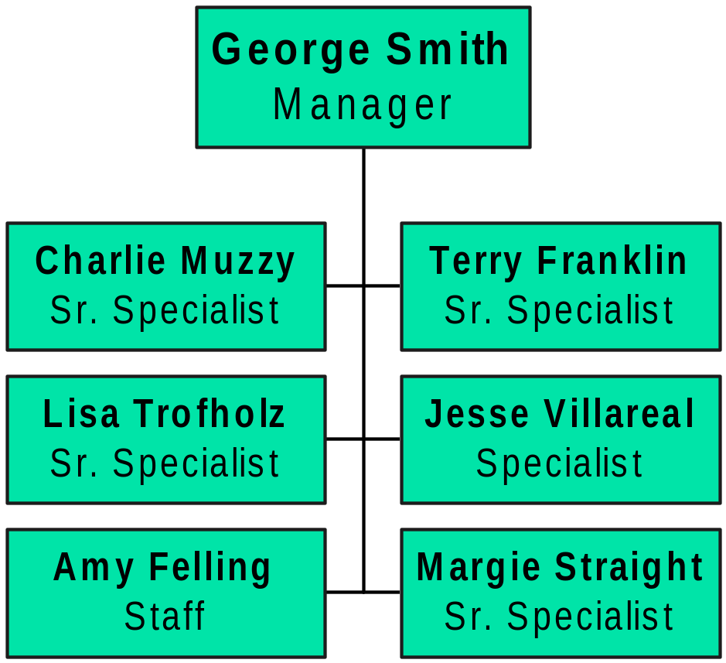
Texas/Wellhead Gas Logistics

Slide 29
Texas Pipelines
Amaco Pipeline
Black Marlin (Blue Dolphin)
Channel Pipeline
Dow Pipeline
Duke Energy Guadalupe
East Texas Gas (ETXC)
EasTrans Pipeline
Houston Pipeline
Lone Star (TXU Gas Dist.)
Moss Bluff Storage (MOSS)
NNGB (formerly Black Marlin)
Oasis Pipeline (OPLC)
Pan Grande
PGE
PowerTex (LG&E Nat)
Sea Hawk-Seagull Shoreline
TUFCO
Winnie Pipeline (Centana)

Slide 30
Wellhead Pipelines
Central Region
ANR Pipeline
Natural Gas Pipeline
NorAm Field Services
NorAm (ARKLA)
Trunkline
UT Offshore
Northeast Region
Central Texas Gathering
Columbia Gas Transmission
Columbia Gulf
Tennessee Gas
Texas Eastern
Transco
Venice Gas Gathering
Southeast Region
Discovery
Florida Gas
KOCH Gateway/United
KOCH Midstream
Southern Natural
Tennessee
Stingray
Texas Gas Transmission

Slide 31
Texas/Wellhead: Asset Management Deals

Slide 32
Texas/Wellhead Gas Logistics Information

Slide 33
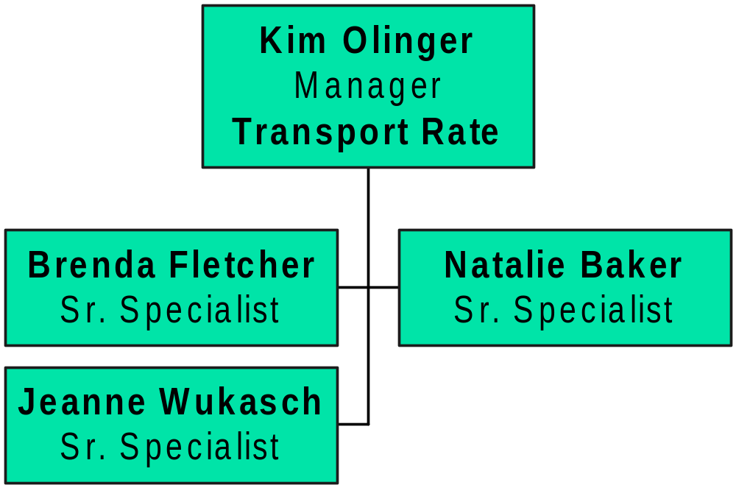
Transport Rate

Slide 34
Transport Rate Regions

Slide 35
Transport Rate Information

